Slide 1
RANDOM PASSWORD GENERATOR
Submitted by
P.L.Charitha(21A85A0406)
T.Abrahama(20A81A0454)
T.Vani Mani Mala(20A81A0455)
Y.Durga Devi(21A85A0408)
T.Avinash(20A81A0453)

Slide 2
CONTENTS
Introduction of Password Generator
Introduction to Tkinter
Creating Window Using Tkinter
Adding Widgets to our application
Geometry Managements
Password Generation
Strength Checker
Character type check

Slide 3
NEED OF PASSWORD GENERATOR
A strong password is a key to protect your personal assets online.
Password Generator is used in a way through which highly secured passwords are generated i.e.,really hard to crack or hack.
THE WAY OF USE
The use of Password Generator is extremely easy.
It requires simple step when we have to select the criteria for the password after selecting the field,all you need is to select the generate password option.
That will help you in getting a password i.e.,absolutely secured and safe to use.

Slide 4
WHY TO USE ?
With help of a generator,it is much easier to create such passwords that are hard to crack even with the use of the software.
GETTING THE SERVICE
The next step is getting hold of a proper way that will help you in getting strong passwords.
There are hundreds of services providers will help you in getting a service that is worth your time and money.
Moreover,it will provide you with the guarantee to be safe.

Slide 5
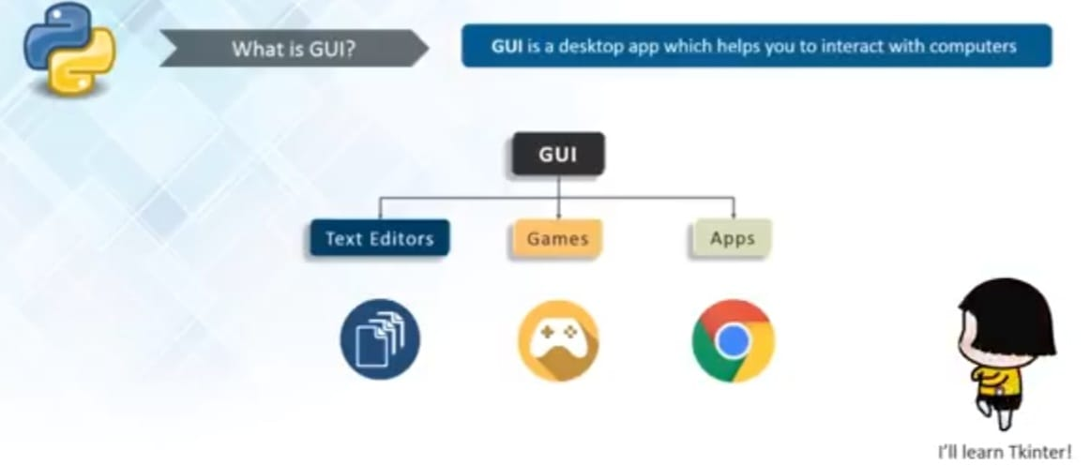

Introduction to Tkinter
Tkinter in python GUI programming is standard python GUI library it gives us an object oriented interface to the Tk GUI tool kit.

Slide 6
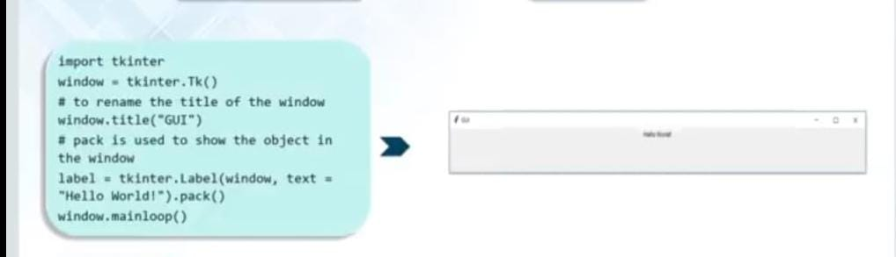
Creating window using Tkinter
Import the Tkinter module
Create the GUI application main window
Enter the main event loop
Add widgets

Slide 7
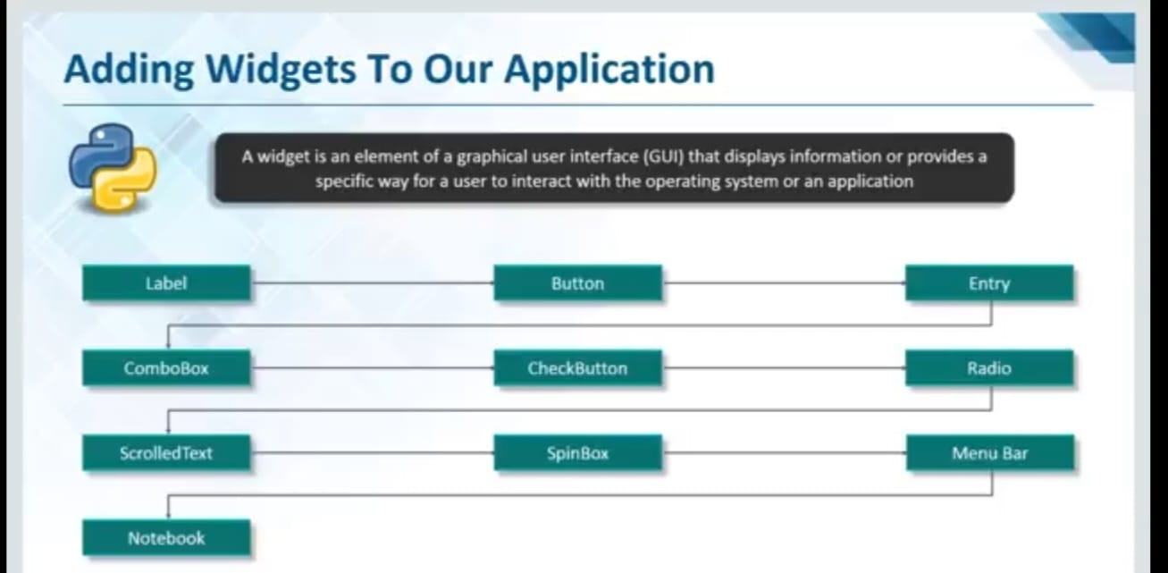

Slide 8
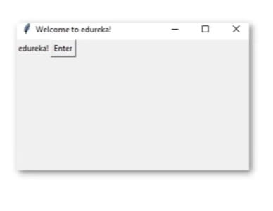
Button Widget
Button
Example
The button widget is used to add buttons in python application.
These buttons can display text or images that convey the purpose of the buttons.
You can attach a function or a method to a button which is called automatically when you click the button
bt=Button(window,text=“Enter”)
bt.grid(column=1,row=0)
def clicked():
l1.configure(text=“Button was clicked!!”)
bt=Button(window,text=“Enter”,command=clicked)

Slide 9
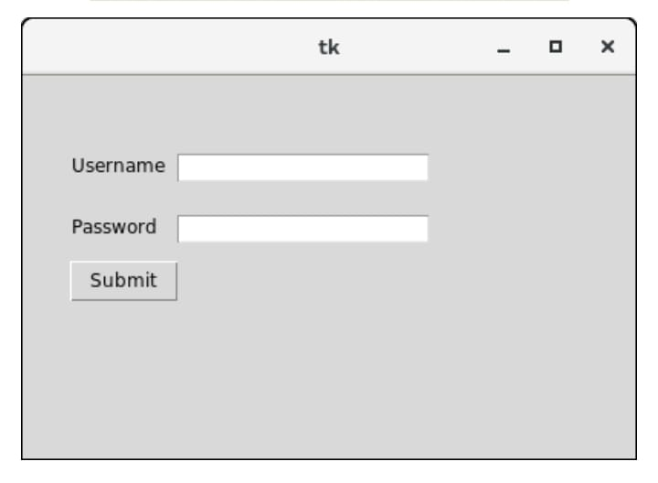
Label widget
Label
Example
The label is used to specify the container box where we can place the text or images.This widget is used to provide the message to the user about other widgets used in the python application.
top=Tk()
Top.geometry(“400*250”)
Uname=Label(top,text=“Username”).place(x=30,y=50)
password=Label(top,text=“Password”).place(x=30,y=90)
Sbmitbtn=Button(top,text=“Submit”).place(x=30,y=120)
e1=Entry(top,width=20).place(x=100,y=50)
e2=Entry(top,width=20).place(x=100,y=90)

Slide 10
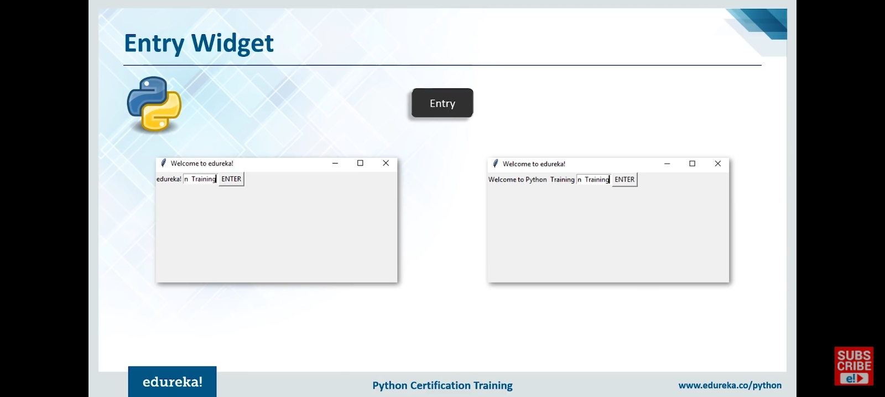
Entry widget
Entry
Example
The entry widget is used to accept single-line text strings from a user.
txt=Entry(window,width=10)
txt.grid(column=1,row=0)
def clicked():
res=“Welcome to”+txt.get()
l1.configure(text=res)
Bt=Button(window,text=“Enter”,command=clicked)

Slide 11
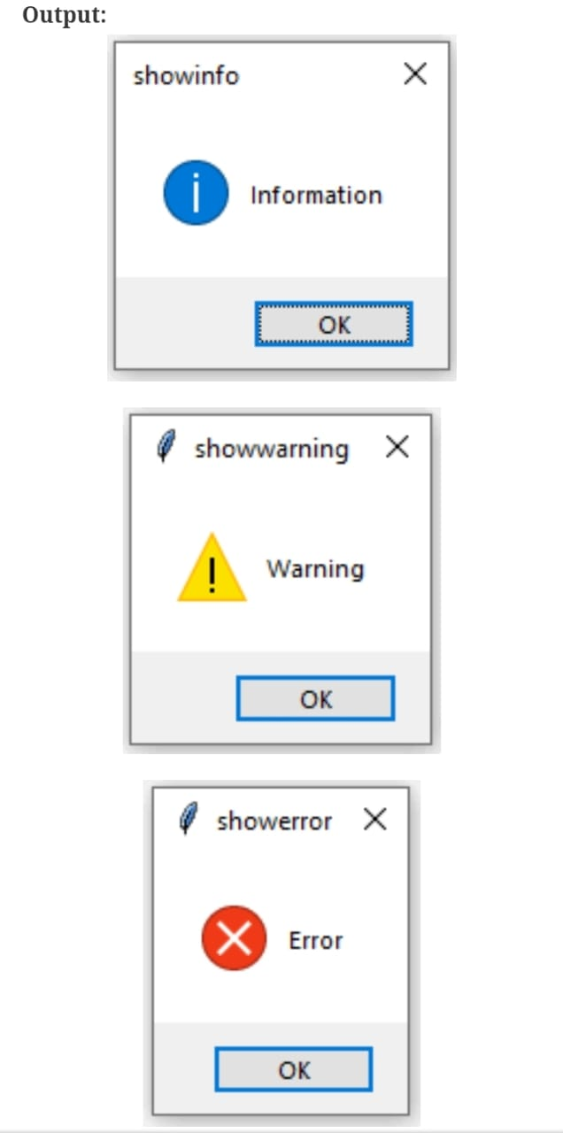
Message Box Widget
Message Box
Example
Message Box widget is used to display the message boxes in the python applications. This module is used to display a messages using provides a number of functions
root=Tk()
Root.geometry(“300*200”)
messagebox.showinfo(“showinfo”,”Information”)
messagebox.showwarning(“showwarning”,”warning”)
Messagebox.showerror(“showerror”,”Error”)

Slide 12
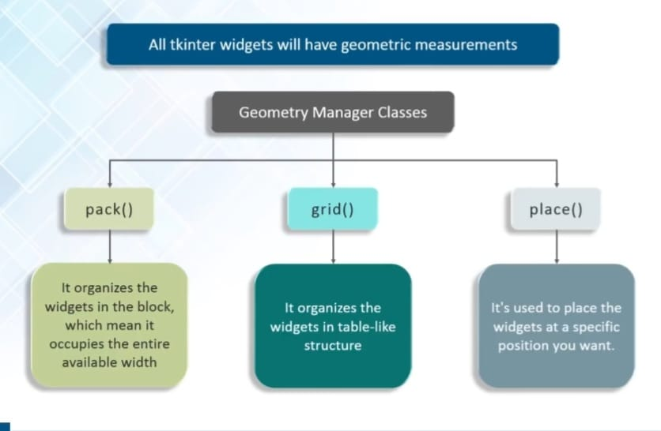
Geometry Managements

Slide 13
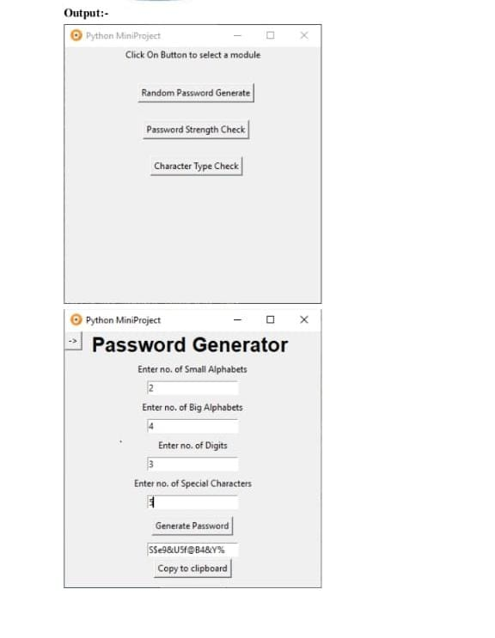
Password Generation
By using first window the user can choose one of the options shown in it.
For generating a random password the user can click the button “Random Password Generate”.
By clicking this button, another window will appear. It consists of some text entries for the specifications of password required by user
to be generated.
Number of small alphabets
Number of Big alphabets
Number of digits
Number of special characters

Slide 14
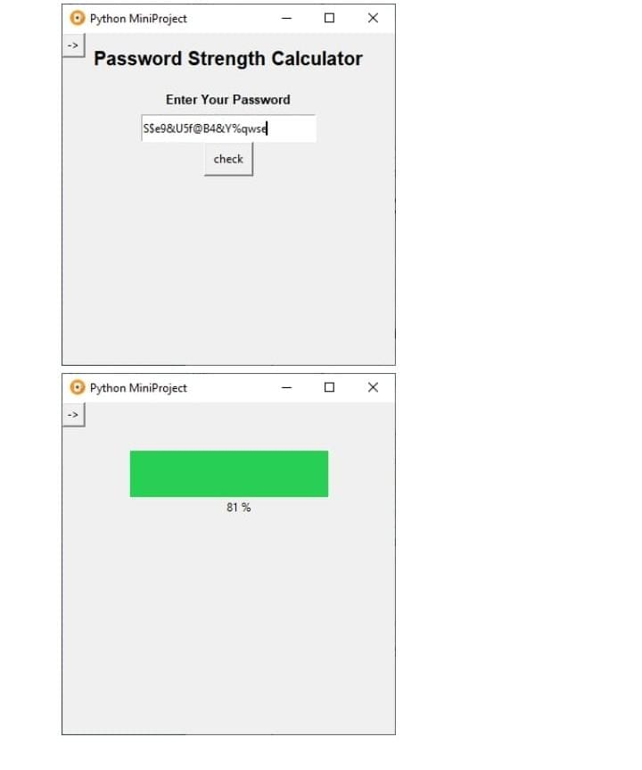
Strength Checker
This window is used to tell the user the strength percent of his /her input password.As the user inputs his password in the text field and click “check” button. A percentage will be displayed indicating the strength of a password. And with the percentage a color box will be displayed.
Red color indicates weak password
Yellow color indicates medium password
Green color indicates strong password

Slide 15
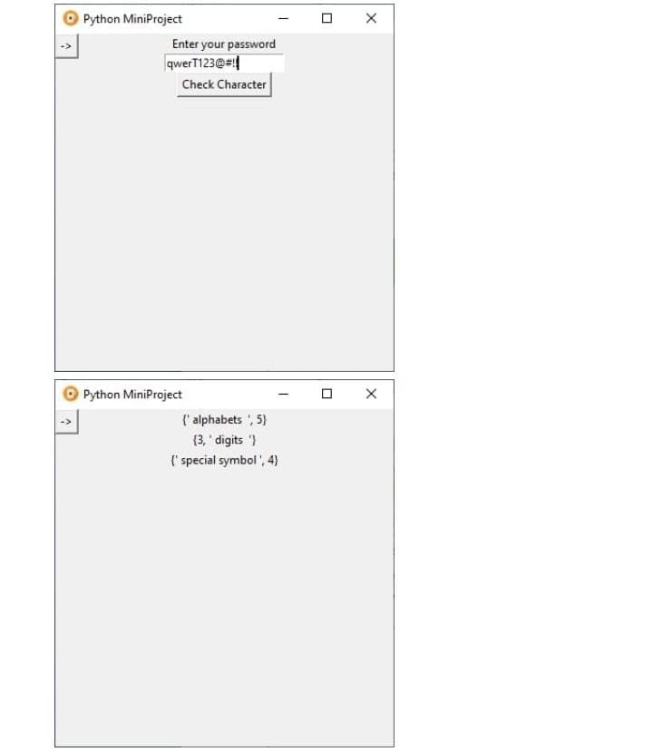
Character Type Check
This window is used to check the characters of a password given as a input by user.
It displays the number of alphabets, digits, and special characters in a given password.

Slide 16
THANK YOU

